Slide 1
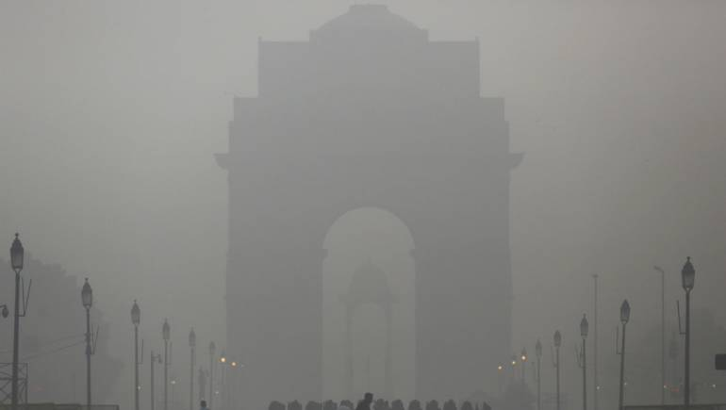
Quantifying the effectiveness of various air pollution reduction schemes in Delhi
Under the guidance of:
Professor Rajesh Sundaresan
Professor Ramesh Hariharan
Presented by:
Bharati Khanijo,
Krithika Subramanian
Sayantika Ghosh

Slide 2
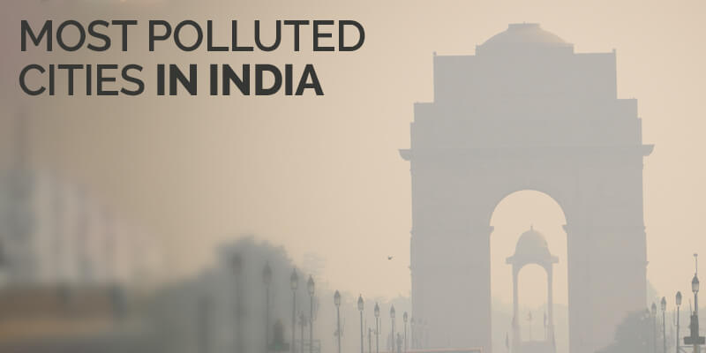
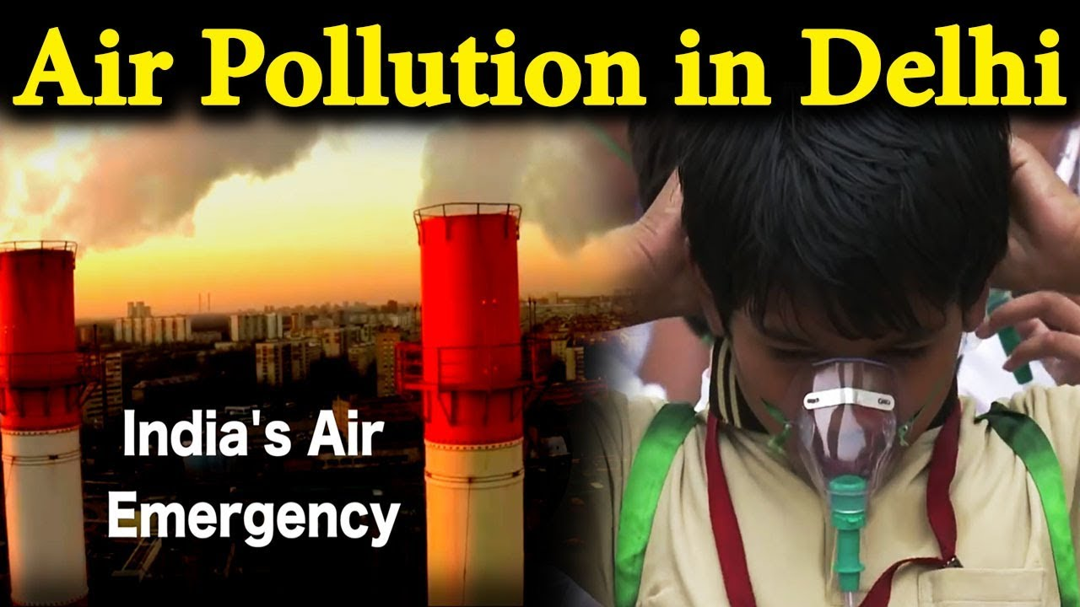

Objective:
To analyze the concentration of various pollutants measured by different measuring stations in Delhi and estimate the effectiveness of different measures taken by the government to improve air quality in the city

Slide 3
Motivation

Slide 4
Most polluted capital in the world
Huge health impact
DELHI AIR POLLUTION
Effectiveness of the policy ???

Slide 5
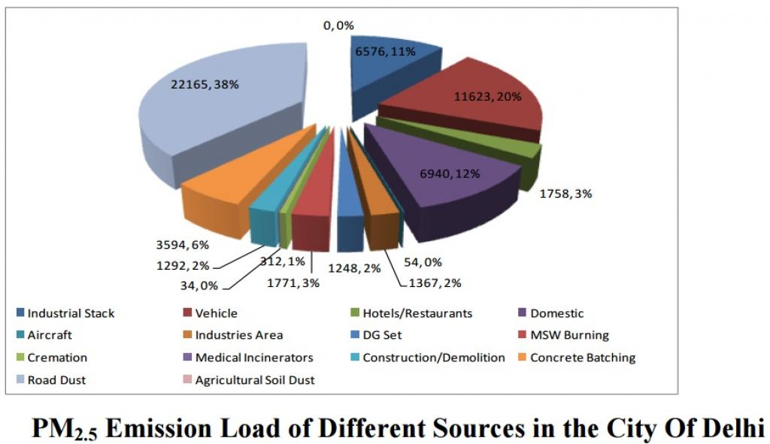
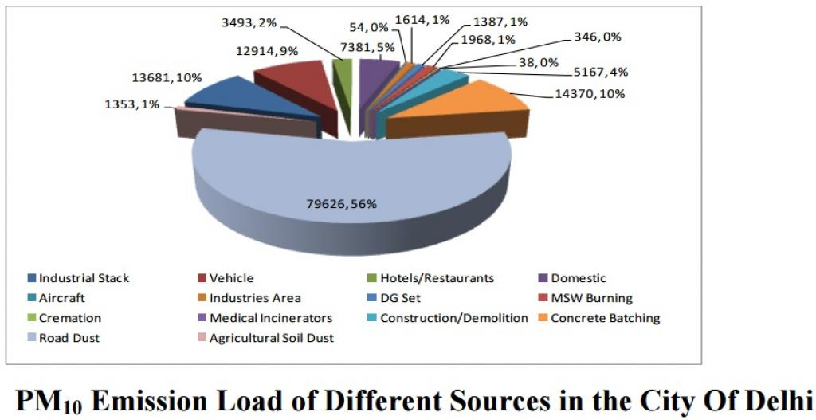
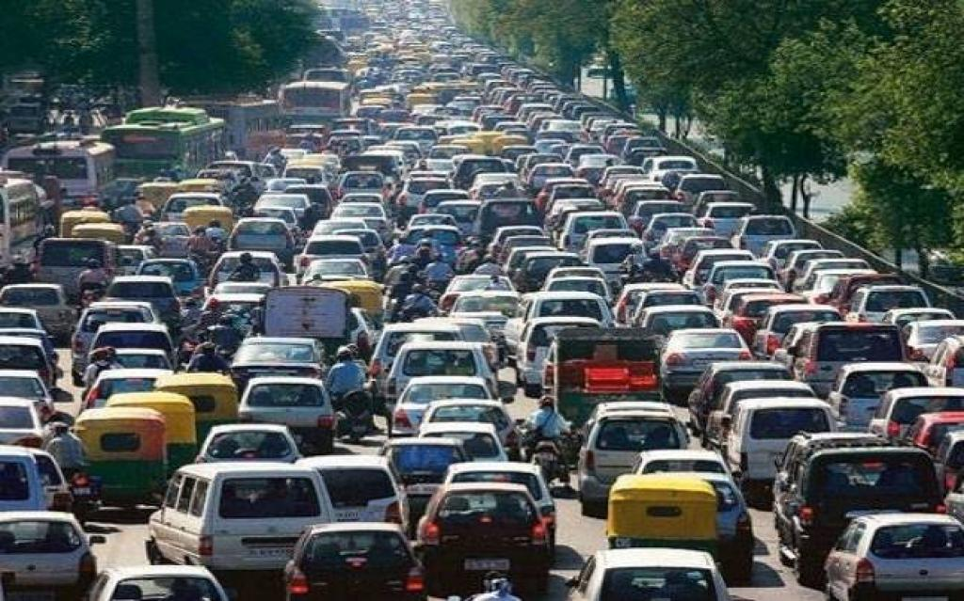
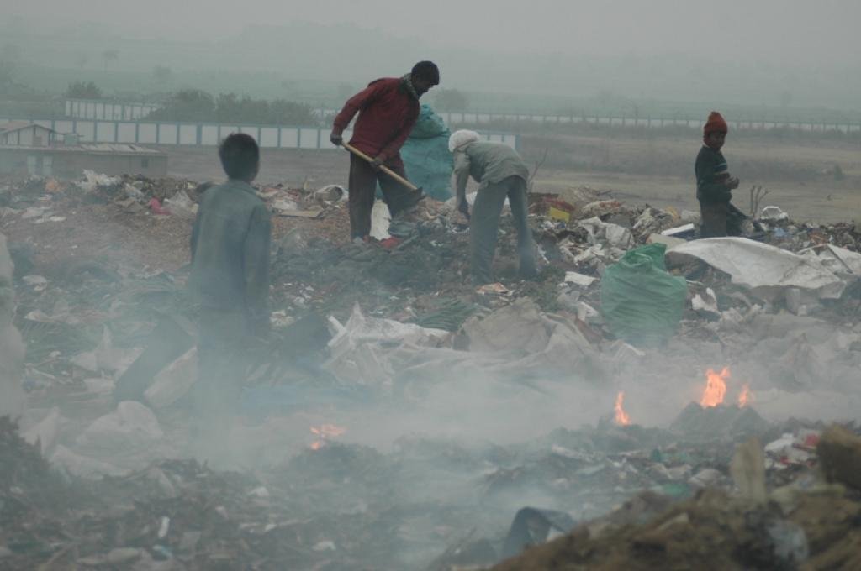
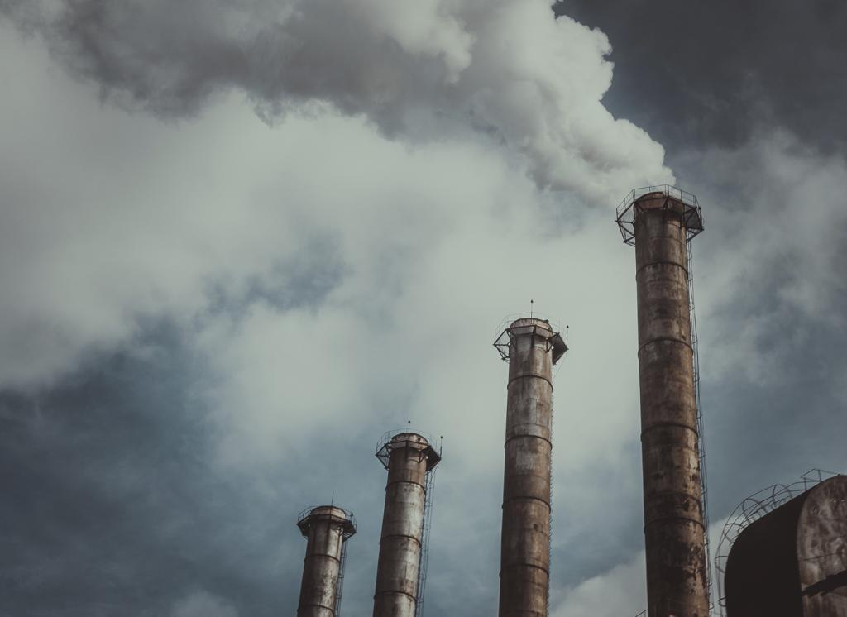

Sources of Air Pollution in Delhi
https://www.downtoearth.org.in/news/air/delhi-air-pollution-identifying-perpetrators-and-fixing-responsibility-56240

Slide 6

Effects on Health
Short-term effects
Irritation to the eyes, nose and throat
Respiratory infections such as bronchitis
Pneumonia
Headaches
Nausea
Allergic reactions.
Short-term air pollution can aggravate the medical conditions of individuals with asthma and emphysema

Slide 7
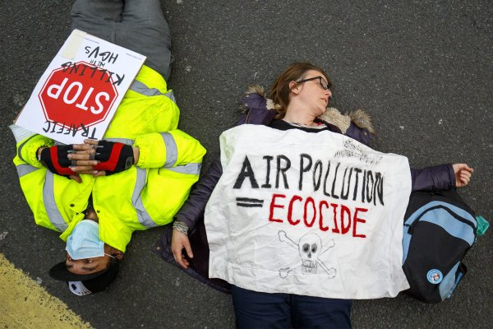
Effects on Health
Long-term Effects
Chronic respiratory diseases
Lung cancer
Heart disease
Damage to the brain, nerves, liver, or kidneys.
Continual exposure to air pollution affects the lungs of growing children and may aggravate or complicate medical conditions in the elderly.
Pre-mature Deaths

Slide 8
AQI | Color Code | Possible Health Impacts
0-50 | Good | minimal impact
51-100 | Satisfactory | minor breathing discomfort to sensitive people
101-200 | Moderate | breathing discomfort to the people with lung disease such as asthma and discomfort to people with heart disease, children and older adults
201-300 | Poor | breathing discomfort to people on prolonged exposure and discomfort to people with heart disease with short exposure
301-400 | Very Poor | respiratory illness to the people on prolonged exposure. Effect may be more pronounced in people with lung and heart diseases
401-500 | Severe | respiratory effects even on healthy people and serious health impacts on people with lung/heart diseases
Above 500 | Emergency | Emergency

Slide 9
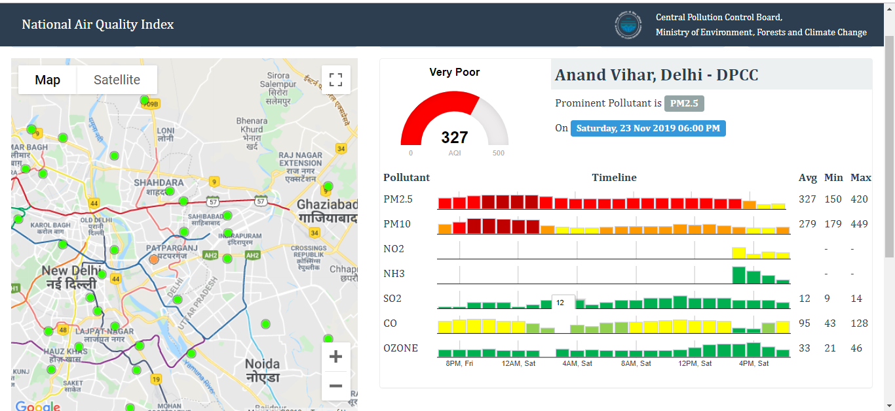
Anand Vihar, Delhi

Slide 10
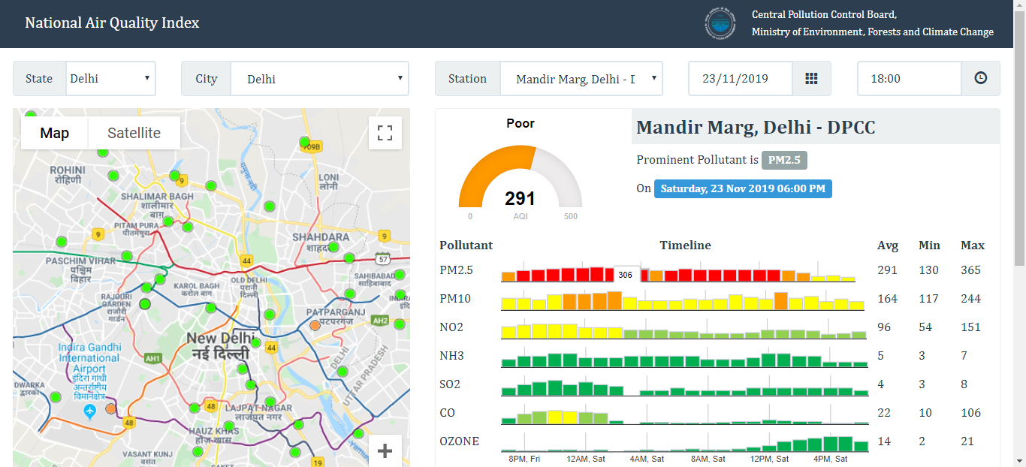
Mandir Marg, Delhi

Slide 11
Our Approach

Slide 12
Problem Domain Selection
Problem Selection
Data Collection
Understanding Data
Diurnal and Seasonal Variation
Missing Values
Correlation
Predicting Pollutant Concentration
Comparing Actual Pollutant Concentration with Predicted Pollutant Concentration
Summarizing Analysis

Slide 13
Calculating Correlation

Slide 14
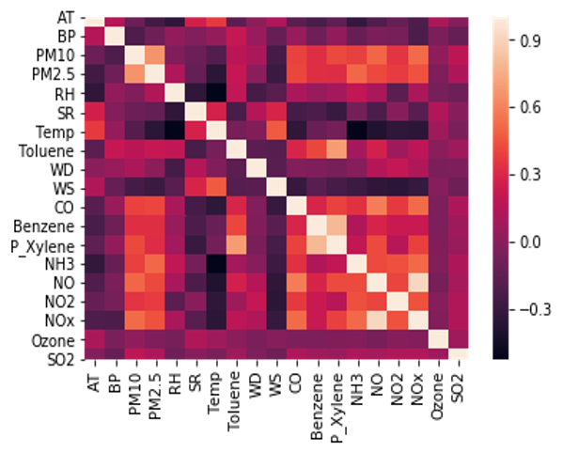
Pearson's correlation coefficient
For Anand Vihar Measuring Station

Slide 15
Predicting Pollutant Concentration

Slide 16
Predicting Pollutant Concentration (Basic Idea)
Average Temperature in °C
Barometric Pressure in mmHg
Relative Humidity %
Solar Radiation in W/m²
Wind Speed in m/s
Predicted concentration of
given Pollutant
Concentration Predictor
Day of the year
Minute of the day
Previous known Concentration of Given Pollutant

Slide 17
Predicting Pollutant Concentration (Continued)
Average Temperature in °C
Barometric Pressure in mmHg
Relative Humidity %
Solar Radiation in W/m²
Wind Speed in m/s
Predicted concentration of
given Pollutant
Concentration Predictor
(Polynomial of degree 2)
Day of the year
Minute of the day
Previous known Concentration of Given Pollutant

Slide 18
Comparing
Actual Pollutant Concentration
with the
Predicted Pollutant Concentration

Slide 19
Schemes analysed
Schemes | Implemented Date
Odd Even rational Scheme | 2019 – Nov 4 to 15 2017 – Nov 13 to 17 2016 – Jan 1 to 15 and April 15 to 30
Banning of construction | 2016 – Nov 9 to 15 2019 – Nov 12 to 23
Combination of banning construction Activity and banning entry of diesel trucks more than 10years | 2017 – Nov 8 to 14
Banning construction activities and Dirty fuel based Industries | 2018 – Dec 24 to 26
Banning construction activities, Dirty fuel based Industries and entry of Trucks | 2018 – Nov 8 to 12

Slide 20
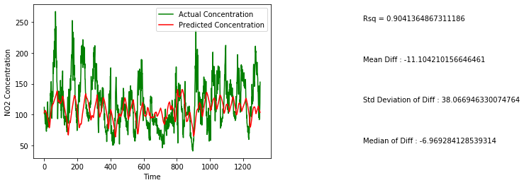
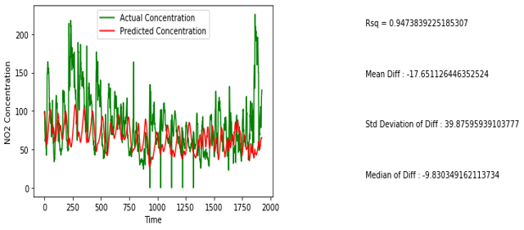
Effect of Odd Even rational Scheme on NO2
Anand Vihar
Mandir Marg

Slide 21
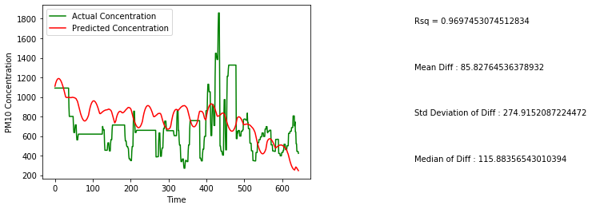
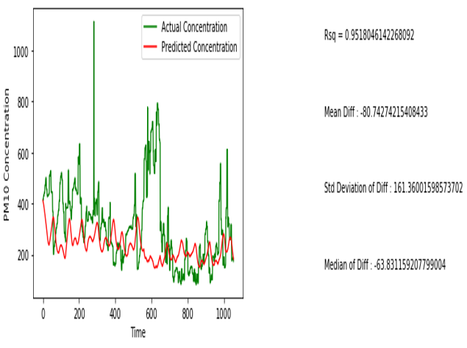
Effect of banning of construction on PM10
Anand Vihar
Mandir Marg

Slide 22
Improvement in Anand Vihar Station
Policy | Pollutant | Mean Concentration Reduction (microgram/m³)
Banning Construction Activities | PM 10 | 85.83
Banning Construction Activities and Entry of diesel trucks more than 10 years old | PM 10 | 5.585
 | PM 2.5 | 6.16
 | NO2 | 8.74
 | SO2 | 1.77
Banning Construction Activities and Dirty Fuel Based Industries | PM 10 | 80.76
 | PM 2.5 | 9.62
 | SO2 | 1.12
Banning Construction Activities, Dirty Fuel Based Industries and Entry of Trucks | PM 10 | 510.80
 | PM 2.5 | 325.10
 | SO2 | 3.83
* According to our pollutant prediction curves

Slide 23
Detailed Analysis

Slide 24
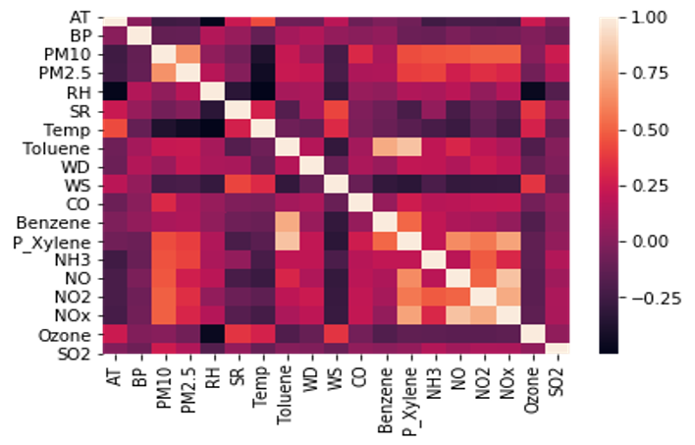
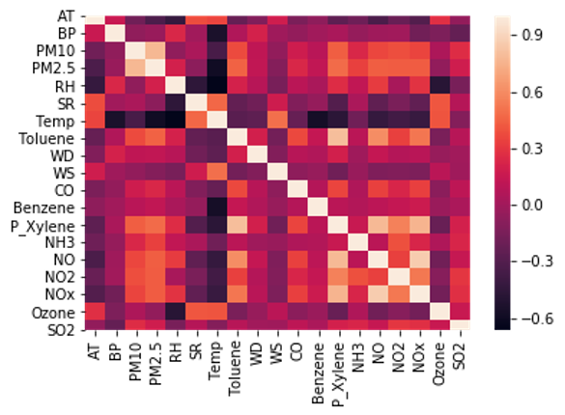
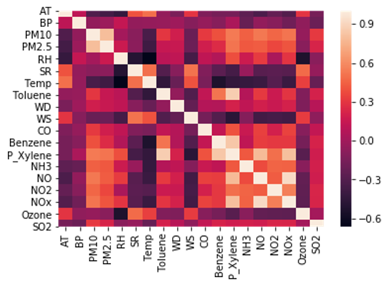
Pearson's correlation coefficient
Anand Vihar
Punjabi Bagh
Mandir Marg
RK Puram

Slide 25
Detailed Predicted Concentration and Actual Concentration Comparitive Analysis

Slide 26
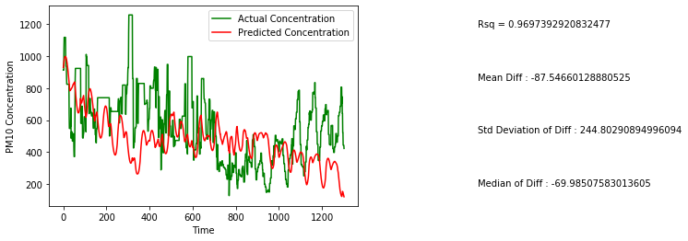
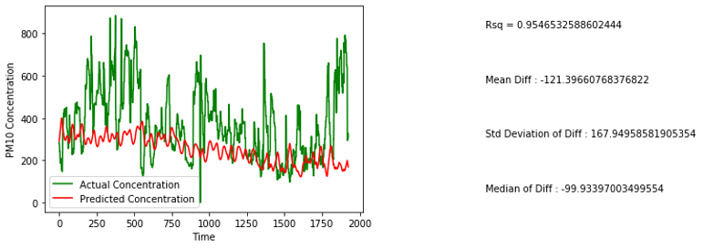
Effect of Odd Even rational Scheme on PM10
Mandir Marg
Anand Vihar

Slide 27
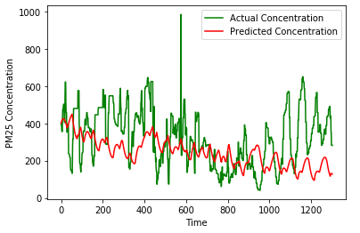
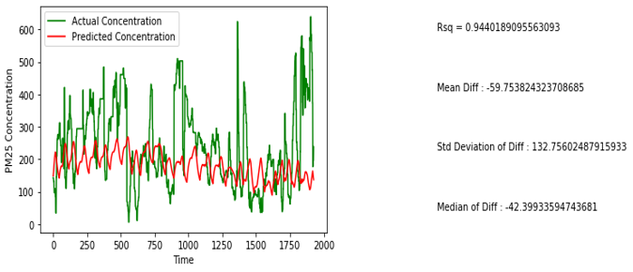
Effect of Odd Even rational Scheme on PM2.5
Mandir Marg
Anand Vihar

Slide 28
Effect of Odd Even rational Scheme on NO2
Mandir Marg
Anand Vihar

Slide 29
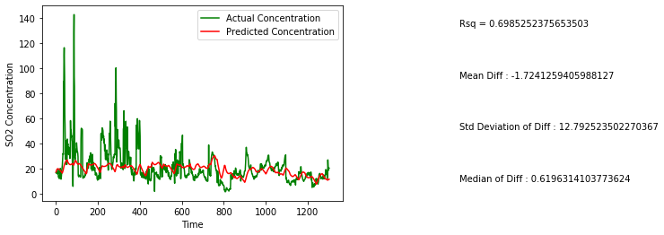
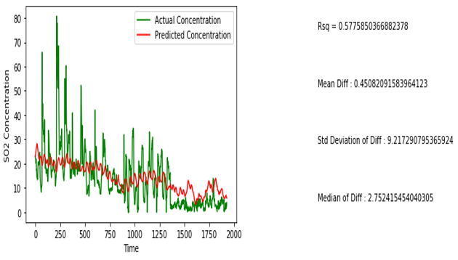
Effect of Odd Even rational Scheme on SO2
Mandir Marg
Anand Vihar

Slide 30
Effect of banning of construction on PM10
Mandir Marg
Anand Vihar

Slide 31
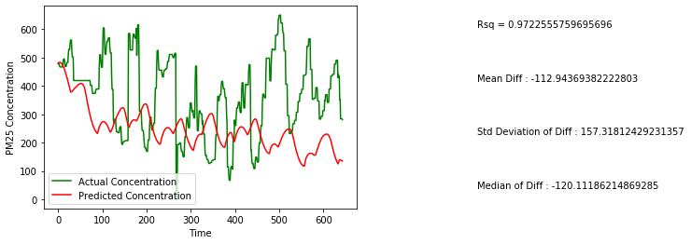
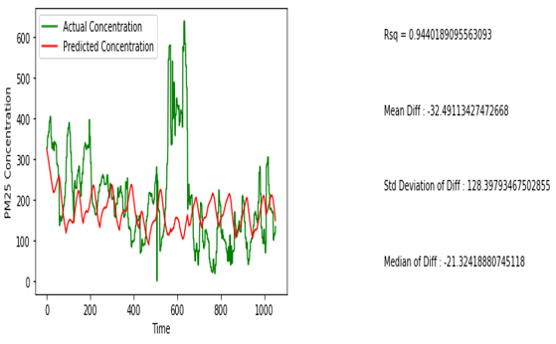
Effect of banning of construction on PM2.5
Mandir Marg
Anand Vihar

Slide 32
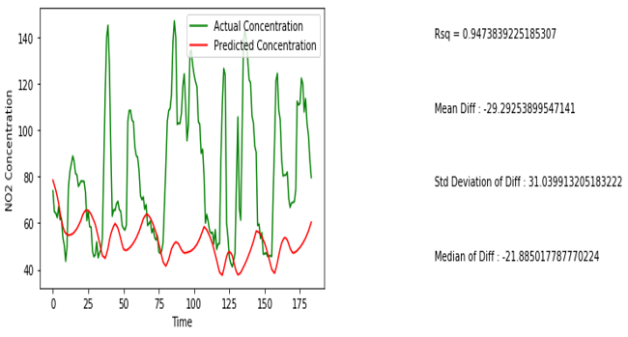
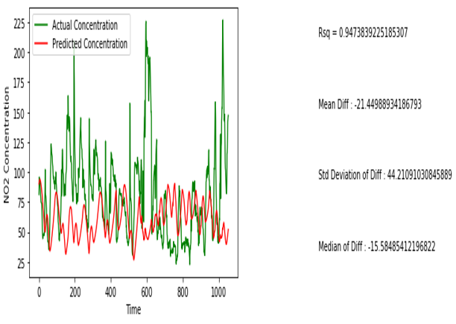
Effect of banning of construction on NO2
Mandir Marg
Anand Vihar

Slide 33
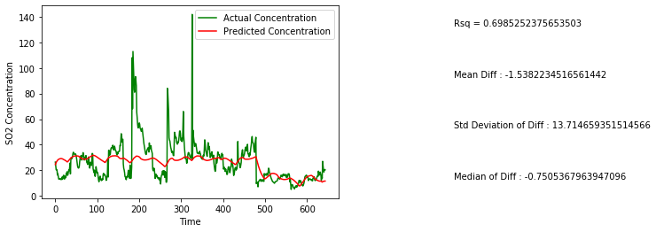
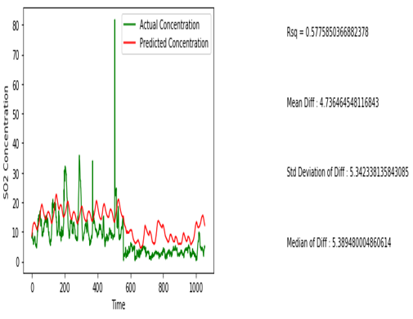
Effect of banning of construction on SO2
Mandir Marg
Anand Vihar

Slide 34
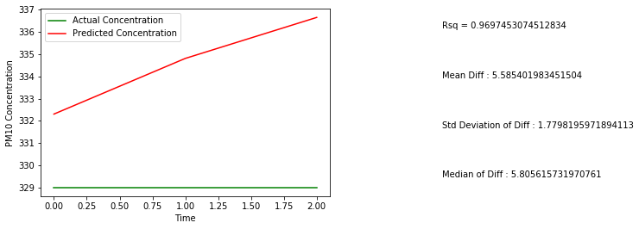
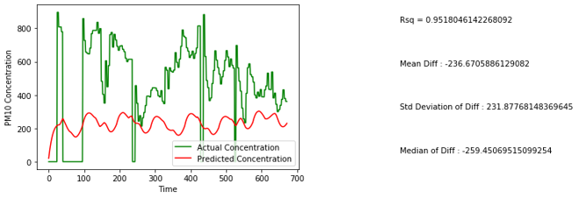
Effect of combination of banning construction Activity and banning entry of diesel trucks more than 10years on PM10
Mandir Marg
Anand Vihar

Slide 35
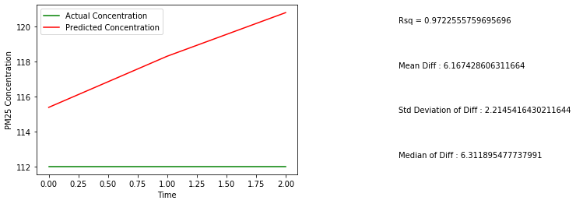
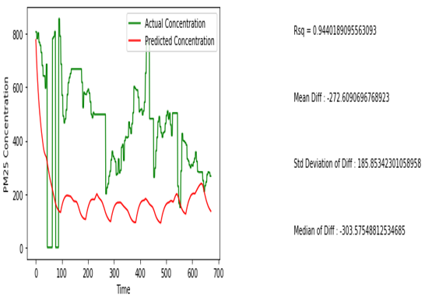
Effect of combination of banning construction Activity and banning entry of diesel trucks more than 10years on PM2.5
Mandir Marg
Anand Vihar

Slide 36
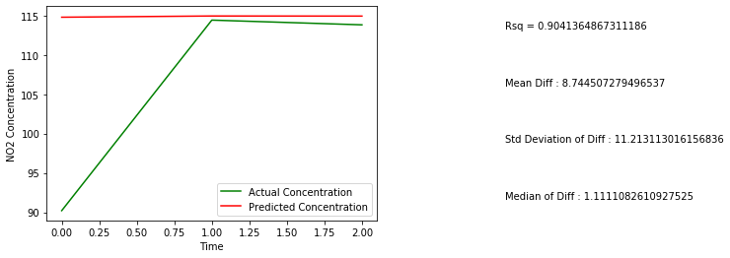
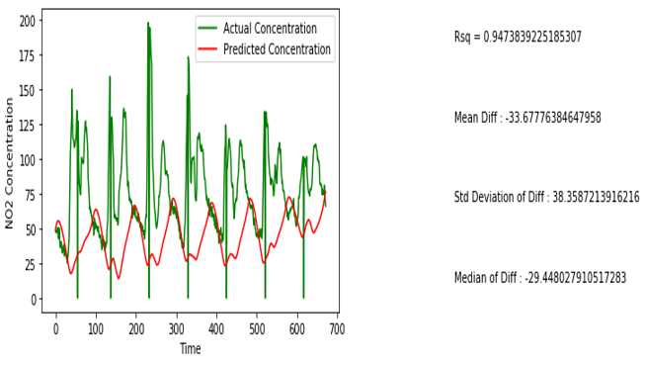
Effect of combination of banning construction Activity and banning entry of diesel trucks more than 10years on NO2
Mandir Marg
Anand Vihar

Slide 37
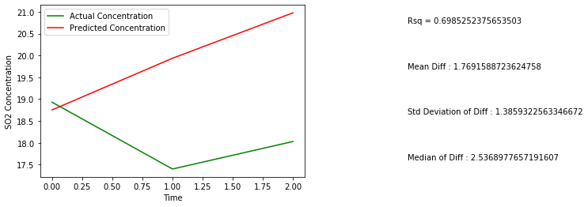
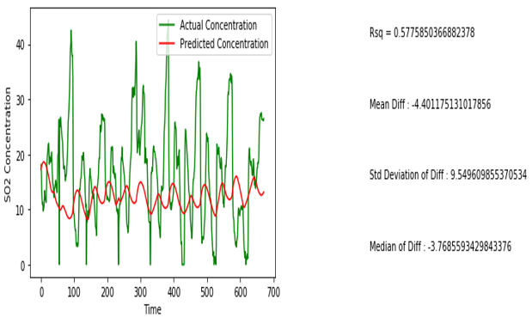
Effect of combination of banning construction Activity and banning entry of diesel trucks more than 10years on SO2
Mandir Marg
Anand Vihar

Slide 38
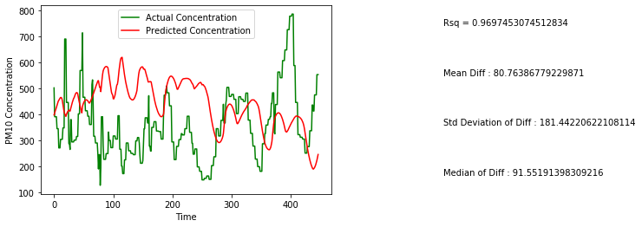
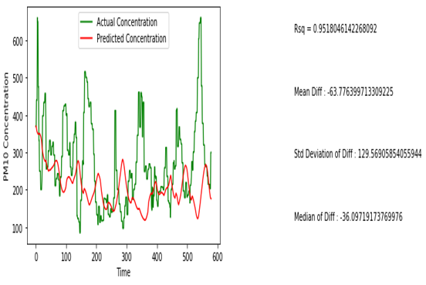
Effects on banning construction activities and Dirty fuel based Industries on PM10
Mandir Marg
Anand Vihar

Slide 39
Effects on banning construction activities and Dirty fuel based Industries on PM2.5
Mandir Marg
Anand Vihar

Slide 40
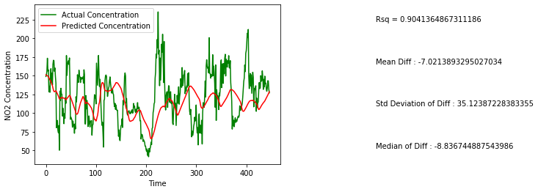
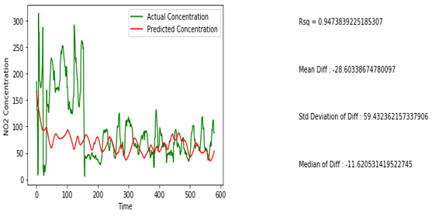
Effects on banning construction activities and Dirty fuel based Industries on NO2
Mandir Marg
Anand Vihar

Slide 41
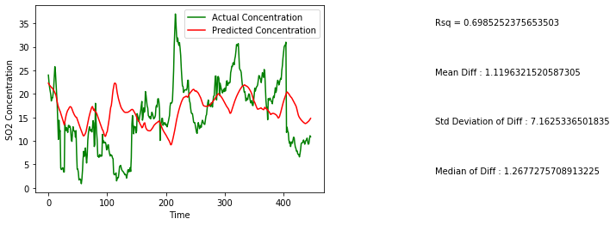
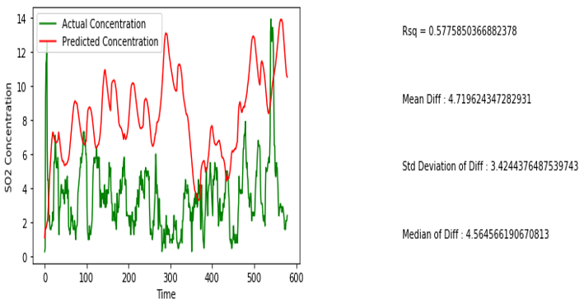
Effects on banning construction activities and Dirty fuel based Industries on SO2
Mandir Marg
Anand Vihar

Slide 42
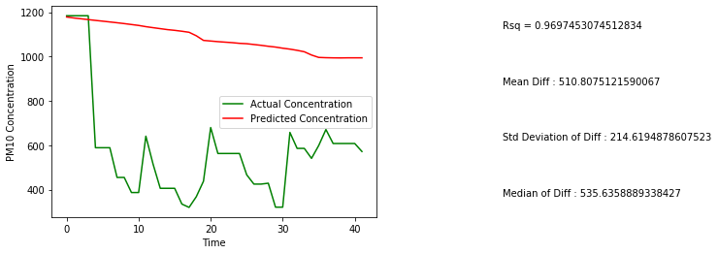
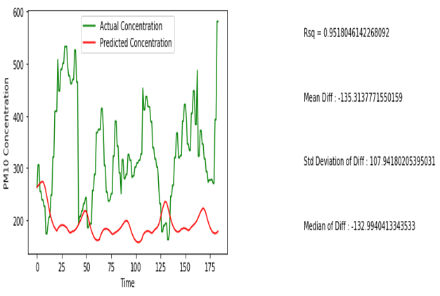
Effects on banning construction activities, Dirty fuel based Industries and entry of Trucks on PM10
Mandir Marg
Anand Vihar

Slide 43
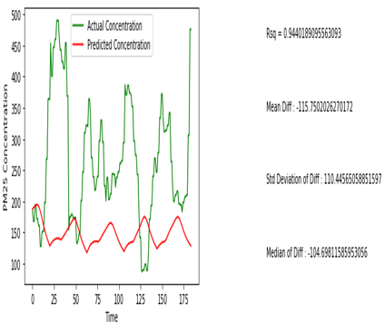
Effects on banning construction activities, Dirty fuel based Industries and entry of Trucks on PM2.5
Mandir Marg
Anand Vihar

Slide 44
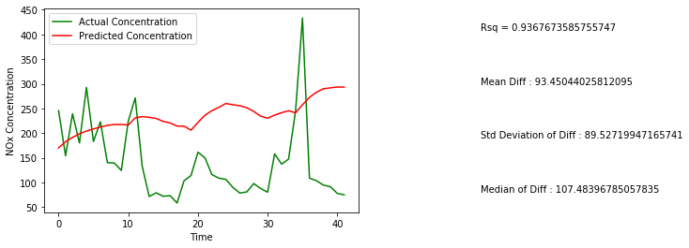
Effects on banning construction activities, Dirty fuel based Industries and entry of Trucks on NO2
Mandir Marg
Anand Vihar

Slide 45
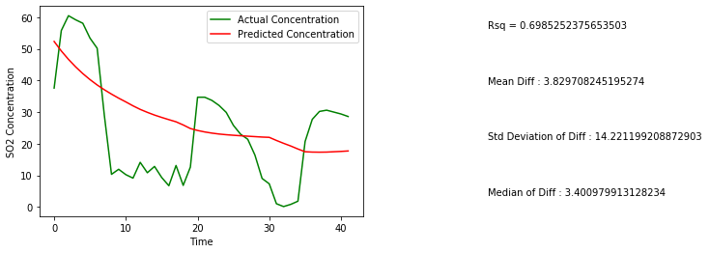

Effects on banning construction activities, Dirty fuel based Industries and entry of Trucks on SO2
Mandir Marg
Anand Vihar

Slide 46
Improvement in Anand Vihar Station
Policy | Pollutant | Mean Concentration Reduction (microgram/m³)
Banning Construction Activities | PM 10 | 85.83
Banning Construction Activities and Entry of diesel trucks more than 10 years old | PM 10 | 5.585
 | PM 2.5 | 6.16
 | NO2 | 8.74
 | SO2 | 1.77
Banning Construction Activities and Dirty Fuel Based Industries | PM 10 | 80.76
 | PM 2.5 | 9.62
 | SO2 | 1.12
Banning Construction Activities, Dirty Fuel Based Industries and Entry of Trucks | PM 10 | 510.80
 | PM 2.5 | 325.10
 | SO2 | 3.83
* According to our pollutant prediction curves

Slide 47
Key Takeaways
One of the major takeaways from this study is that the concentration of pollutant decreases only in regions where that pollutant is the major contributor
Also the effect of stubble burning on our data and the implementation of various measures

Slide 48
References
Central Pollution Control Board (CPCB) Air Quality Data, ”https://app.cpcbccr.com/ccr//caaqm-dashboard-all/caaqm-landing”
https://economictimes.indiatimes.com/news/politics-and-nation/ban-on-night-time-construction-in-ncr-extended-till-saturday/articleshow/71838547.cms
https://www.indiatoday.in/india/story/delhi-ncr-s-dirty-fuel-driven-industries-to-remain-shut-till-nov-8-epca-1615732-2019-11-05
https://www.indiatoday.in/india/story/air-pollution-sc-bans-construction-demolition-burning-of-waste-in-delhi-ncr-1615731-2019-11-05
https://economictimes.indiatimes.com/news/politics-and-nation/epca-shuts-industries-in-delhis-pollution-hotspots-bans-construction-activities-till-wednesday/articleshow/67230110.cms?from=mdr
https://www.livemint.com/Politics/MHVjYfmyoaZVnnYKg2mFzK/Delhi-air-pollution-NGT-imposes-ban-on-industrial-construc.html
https://economictimes.indiatimes.com/news/politics-and-nation/ngt-gets-cracking-on-pollution-in-delhi-ncr-bans-all-construction-work-for-7-days/articleshow/55311680.cms?from=mdr
https://www.jagranjosh.com/current-affairs/what-is-oddeven-rule-that-will-be-implemented-in-delhi-from-4-to-15-november-1568360599-1

Slide 49
Thank You !

Slide 50


Slide 51


Slide 52
Motivation
Delhi – the most polluted capital in the world
Given the huge impact on the health and environment Delhi Government implemented many policies to reduce the pollution levels in Delhi
The effectiveness of these policies are not still fully described.
So the main motivation behind this study is to show the quantitative effectiveness of odd even road rationing scheme over other implemented schemes.

Slide 53
Results

Slide 54
Challenges
In the first phase of data collection, we were having issues in downloading data from CPCB website due to slow and 404 response from server.
In the second phase of understanding the data we found that for a given station, different parts of data was missing for long continuous intervals of time due to malfunctioning of the measuring sensor.
During implementation we found that the dates of implementation of various schemes were mostly in the month of November, thus reducing the data base during that period.
Also, it was observed that several meteorological parameters have correlation with the concentration of pollutants
A major challenge we faced was to provide an estimate quantifying the benefits offered by various schemes, in the backdrop of the effect of wind, diurnal variations and other seasonal factors.

Slide 55
Missing Data ?
Drop Corresponding Rows
Simple Interpolation
Different Meteorological Parameters show different trends based on the time of the day
No data during implementation of schemes

